Slide 1




Static Members and Namespaces
Static Members, Indexers, Operators, Namespaces
Svetlin Nakov
Technical Trainer
Mr. Namespace
www.nakov.com
Software University
http://softuni.bg

Slide 2


Table of Contents
+-=/
Static Members
Namespaces
Indexers
Operators
[5]

Slide 3

Static Members
Static vs. Instance Members

Slide 4

Static Members
Static members are associated with a class (type)
Rather than with an object (instance)
Defined with the modifier static
Static can be used for
Fields
Properties
Methods
Events
Constructors

Slide 5
Static vs. Non-Static
Static:
Associated with a type (class), not with an instance
Non-Static:
The opposite, associated with an instance (object)
Static:
Initialized just before the type is used for the first time
Non-Static:
Initialized when the constructor is called

Slide 6
Static Counter – Example
public class Person
{
private static int instanceCounter = 0;
public string Name { get; set; }
public static int PersonCounter
{
get { return Person.instanceCounter; }
}
public Person(string name = null)
{
Person.instanceCounter++;
this.Name = name;
}
}

Slide 7

Static Members – Example
static class SqrtPrecalculated
{
public const int MAX_VALUE = 10000;
// Static field
private static int[] sqrtValues;
// Static constructor
static SqrtPrecalculated()
{
sqrtValues = new int[MAX_VALUE + 1];
for (int i = 0; i < sqrtValues.Length; i++)
{
sqrtValues[i] = (int)Math.Sqrt(i);
}
} (example continues)

Slide 8

Static Members – Example (2)
// Static method
public static int GetSqrt(int value)
{
return sqrtValues[value];
}
}
class SqrtTest
{
static void Main()
{
Console.WriteLine(SqrtPrecalculated.GetSqrt(254));
// Result: 15
}
}

Slide 9

Static Members
Live Demo

Slide 10

Indexers
public int this [int index]
{
…
}
var value = list[5];

Slide 11
Indexers
Indexers provide indexed access to class data
Predefine the [] operator for a certain type
Like when accessing array elements
Can accept one or multiple parameters
Defining an indexer:
IndexedType t = new IndexedType(50);
int i = t[5];
t[0] = 42;
personInfo["Svetlin Nakov", 28]
public int this [int index] { … }

Slide 12
Indexers – Example
struct BitArray32
{
private uint value;
// Indexer declaration
public int this [int index]
{
get
{
if (index >= 0 && index <= 31)
{
// Check the bit at position index
if ((value & (1 << index)) == 0)
return 0;
else
return 1;
}
(the example continues)

Slide 13
Indexers – Example (2)
else
{
throw new IndexOutOfRangeException(
String.Format("Index {0} is invalid!", index));
}
}
set
{
if (index < 0 || index > 31)
throw new IndexOutOfRangeException(
String.Format("Index {0} is invalid!", index));
if (value < 0 || value > 1)
throw new ArgumentException(
String.Format("Value {0} is invalid!", value));
// Clear the bit at position index
value &= ~((uint)(1 << index));
// Set the bit at position index to value
value |= (uint)(value << index);
}

Slide 14
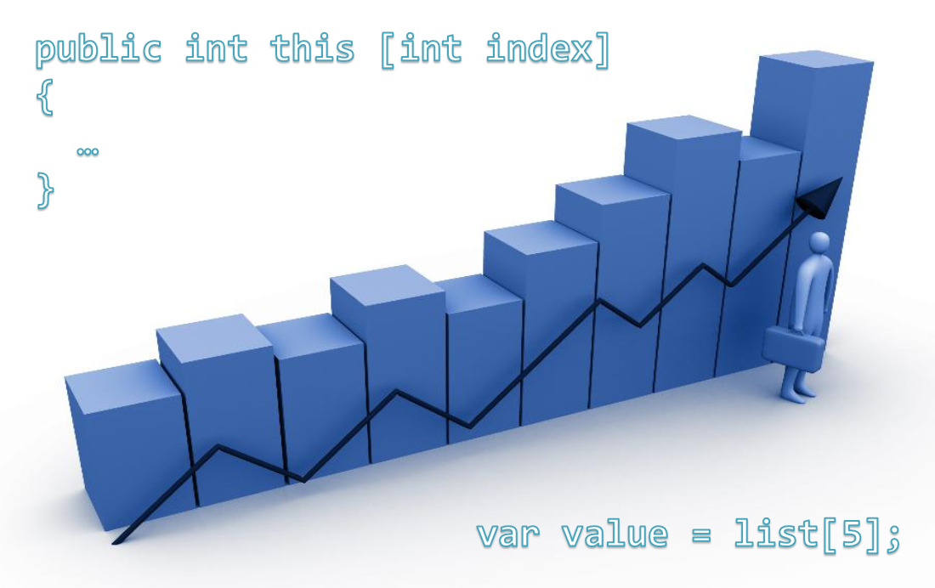
Indexers
Live Demo

Slide 15


Operators Overloading

Slide 16
Overloading Operators
In C# operators can be overloaded (redefined) by developers
The priority of operators cannot be changed
Not all operators can be overloaded
Overloading an operator in C#
Looks like a static method with 2 parameters:
public static Matrix operator *(Matrix m1, Matrix m2)
{
return new m1.Multiply(m2);
}

Slide 17
Overloading Operators (2)
Overloading is allowed on:
Unary operators
Binary operators
Operators for type conversion
Implicit type conversion
Explicit type conversion (type)
+, -, !, ~, ++, --, true and false
+, -, *, /, %, &, |, ^, <<, >>, ==, !=, >, <, >= and <=

Slide 18
Overloading Operators – Example
public static Fraction operator -(Fraction f1,Fraction f2)
{
long num = f1.numerator * f2.denominator -
f2.numerator * f1.denominator;
long denom = f1.denominator * f2.denominator;
return new Fraction(num, denom);
}
public static Fraction operator *(Fraction f1,Fraction f2)
{
long num = f1.numerator * f2.numerator;
long denom = f1.denominator * f2.denominator;
return new Fraction(num, denom);
}
(the example continues)

Slide 19
Overloading Operators – Example (2)
// Unary minus operator
public static Fraction operator -(Fraction fraction)
{
long num = -fraction.numerator;
long denom = fraction.denominator;
return new Fraction(num, denom);
}
// Operator ++ (the same for prefix and postfix form)
public static Fraction operator ++(Fraction fraction)
{
long num = fraction.numerator + fraction.denominator;
long denom = Frac.denominator;
return new Fraction(num, denom);
}

Slide 20

Overloading Operators
Live Demo

Slide 21


Namespaces
Grouping Classes

Slide 22
Namespaces
Namespaces logically group type definitions
May contain classes, structures, interfaces, enumerators and other types and namespaces
Cannot contain methods and data directly
Can be allocated in one or several files
C# namespaces in are similar to C++ namespaces and Java packages
Allows defining types with duplicated names
E.g. a class named Button is found in Windows Forms, in WPF and in ASP.NET Web Forms

Slide 23
Including Namespaces
Including a namespace
The using directive is put at the start of the file
using allows direct use of all types in the namespace
Including is applied to the current file
The directive is written at the beginning of the file
When including a namespace with using its nested namespaces are not included
using System.Windows.Forms;

Slide 24
Including Namespaces (2)
Types, placed in namespaces, can be used and without using directive, by their full name:
using can create allies for namespaces :
System.IO.StreamReader reader =
System.IO.File.OpenText("file.txt");
using IO = System.IO;
using WinForms = System.Windows.Forms;
IO.StreamReader reader =
IO.File.OpenText("file.txt");
WinForms.Form form = new WinForms.Form();

Slide 25
Defining Namespaces
Divide the types in your applications into namespaces
When the types are too much (more than 15-20)
Group the types logically in namespaces according to their purpose
Use nested namespaces when the types are too much
E.g. for a Tetris game you may have the following namespaces: Tetris.Core, Tetris.Data, Tetris.Web, Tetris.HTML5Client

Slide 26
Defining Namespaces (2)
Distribute all public types in files identical with their names
E.g. the class Student should be in the file Student.cs
Arrange the files in directories, corresponding to their namespaces
The directory structure from your project course-code have to reflect the structure of the defined namespaces

Slide 27
Namespaces – Example
namespace SoftUni.Data
{
public struct Faculty
{
// …
}
public class Student
{
// …
}
public class Professor
{
// …
}
public enum Specialty
{
// …
}
}

Slide 28
Namespaces – Example (2)
namespace SoftUni.UI
{
public class StudentAdminForm : System.Windows.Forms.Form
{
// …
}
public class ProfessorAdminForm : System.Windows.Forms.Form
{
// …
}
}
namespace SoftUni
{
public class AdministrationSystem
{
public static void Main()
{
// …
}
}
}

Slide 29
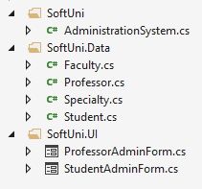
Namespaces – Example (3)
Recommended directory structure and class organization

Slide 30

Namespaces
Live Demo

Slide 31


Summary
Static members are shared between all instances
Instance members are per object
Indexers allow indexed access to class data
Operator overloading redefining the functionality of the standard operators
Namespaces are logically group code around some particular functionality

Slide 32
OOP – Static Members and Namespaces
https://softuni.bg/trainings/coursesinstances/details/8

Slide 33
License
This course (slides, examples, demos, videos, homework, etc.) is licensed under the "Creative Commons Attribution-NonCommercial-ShareAlike 4.0 International" license
Attribution: this work may contain portions from
"OOP" course by Telerik Academy under CC-BY-NC-SA license

Slide 34







SoftUni Diamond Partners

Slide 35





Free Trainings @ Software University
Software University Foundation – softuni.org
Software University – High-Quality Education, Profession and Job for Software Developers
softuni.bg
Software University @ Facebook
facebook.com/SoftwareUniversity
Software University @ YouTube
youtube.com/SoftwareUniversity
Software University Forums – forum.softuni.bg

